Slide 1
Netflix Dataset EDA
A Machine Learning & Artificial Intelligence Project
Project By: Manjeet Kumar

Slide 2

Project Overview & Data Loading
This project involves an Exploratory Data Analysis (EDA) of the Netflix dataset, utilizing Python libraries such as Pandas, NumPy, Matplotlib, and Seaborn for data manipulation and visualization.
Libraries Imported
Pandas for data handling
NumPy for numerical operations
Matplotlib & Seaborn for visualizations
WordCloud for text analysis
Dataset Loaded
The Netflix dataset was successfully loaded, containing 8807 rows and 12 columns.
Initial inspection reveals a mix of object and integer data types.

Slide 3
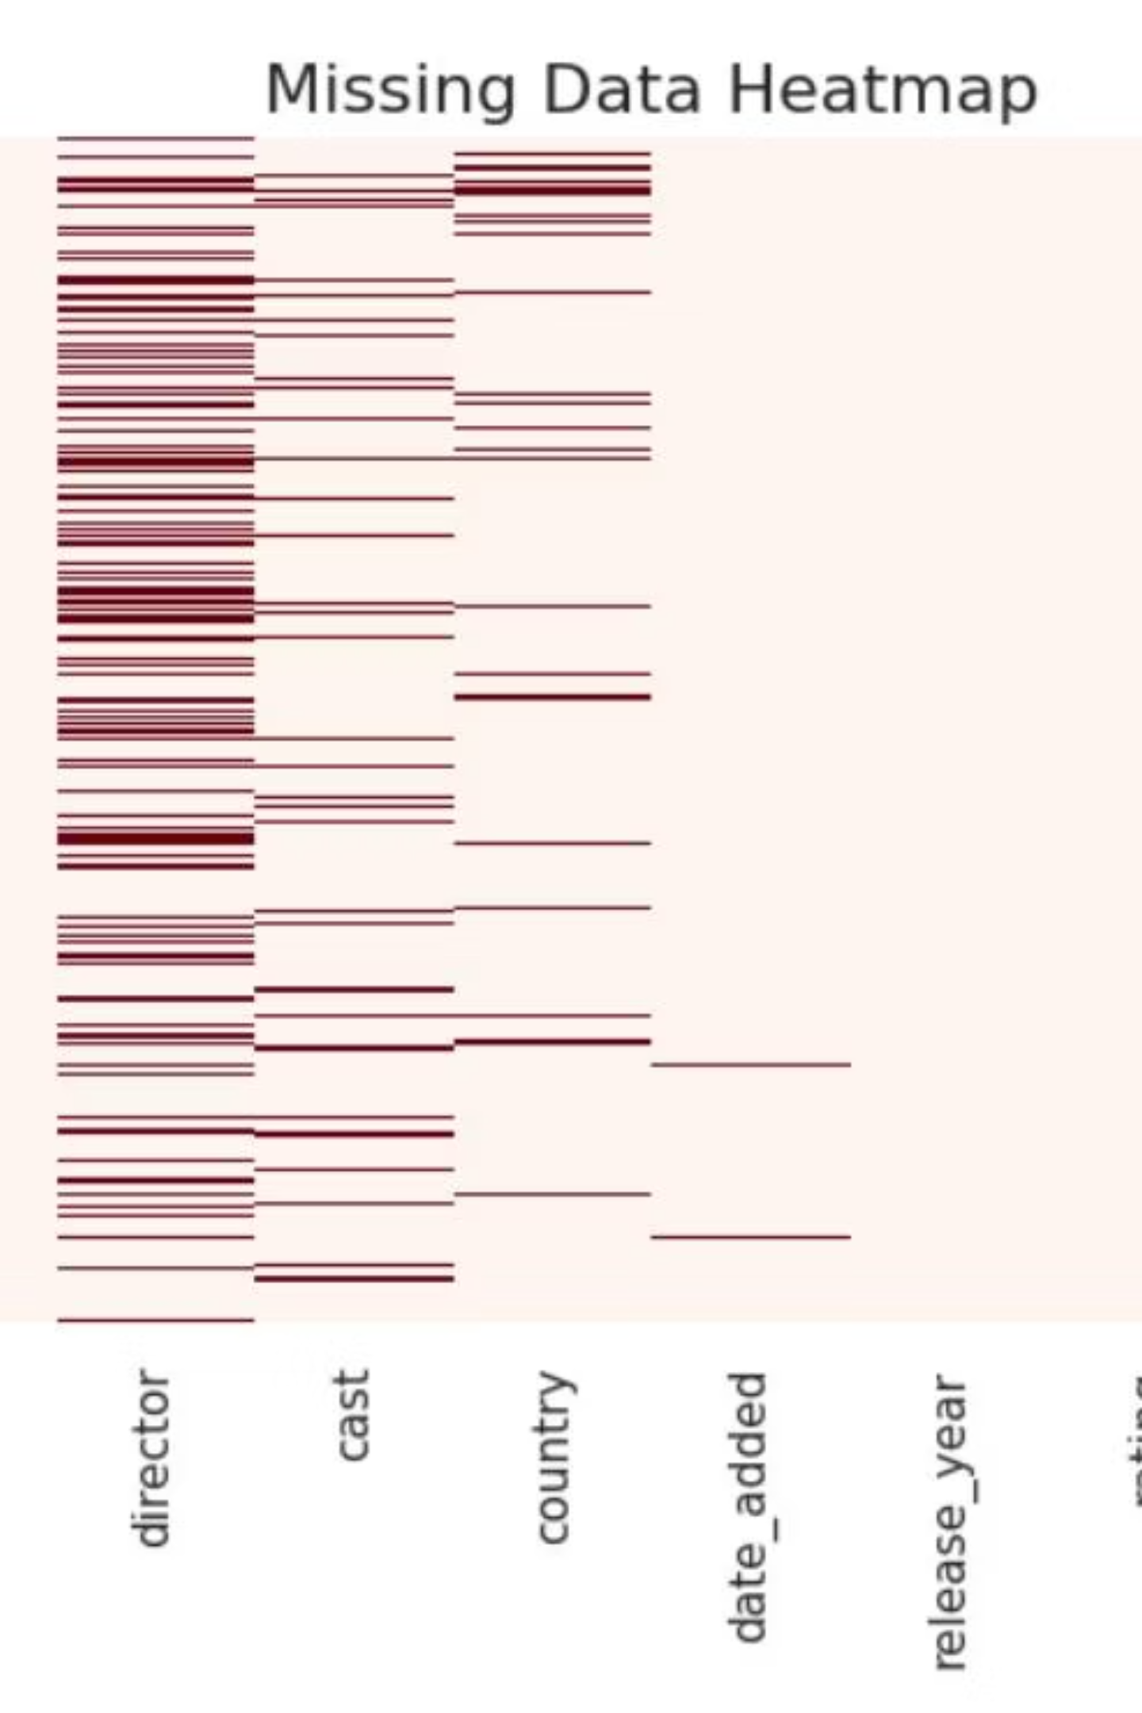
Initial Data Inspection
A crucial step in EDA is to preview the data and identify any missing values. This helps in understanding the dataset's structure and planning for data cleaning.
Dataset Head
Missing Values Overview
Significant missing values were identified in 'director', 'cast', 'country', 'date_added', 'rating', and 'duration'.
The first few rows provide a glimpse into the content, including show ID, type, title, director, cast, country, date added, release year, rating, duration, listed in, and description.
The heatmap visually confirms the extent of these missing data points, particularly for 'director' and 'cast'.
Example entries show both movies and TV shows, with varying levels of detail across columns.

Slide 4




Data Cleaning and Preparation
Before analysis, the dataset underwent cleaning to ensure accuracy and consistency. This involved handling duplicates and converting data types.
Duplicate Removal
Date Conversion
Year Extraction
All duplicate entries were removed to prevent skewed analysis, ensuring each record is unique.
The 'date_added' column was converted to datetime objects, with 10 rows unparseable due to formatting issues.
A new 'year_added' column was created from 'date_added' to facilitate time-series analysis.

Slide 5


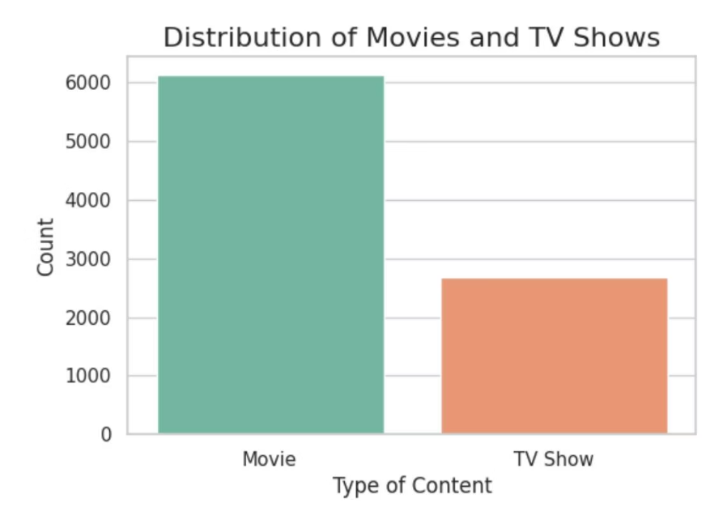
Content Distribution: Movies vs. TV Shows
An initial look at the content library reveals a clear dominance of one content type over the other.
Content Type Breakdown
The distribution chart clearly shows that movies constitute a larger portion of Netflix's content library compared to TV shows.
This insight is fundamental for understanding Netflix's content strategy and audience focus.

Slide 6


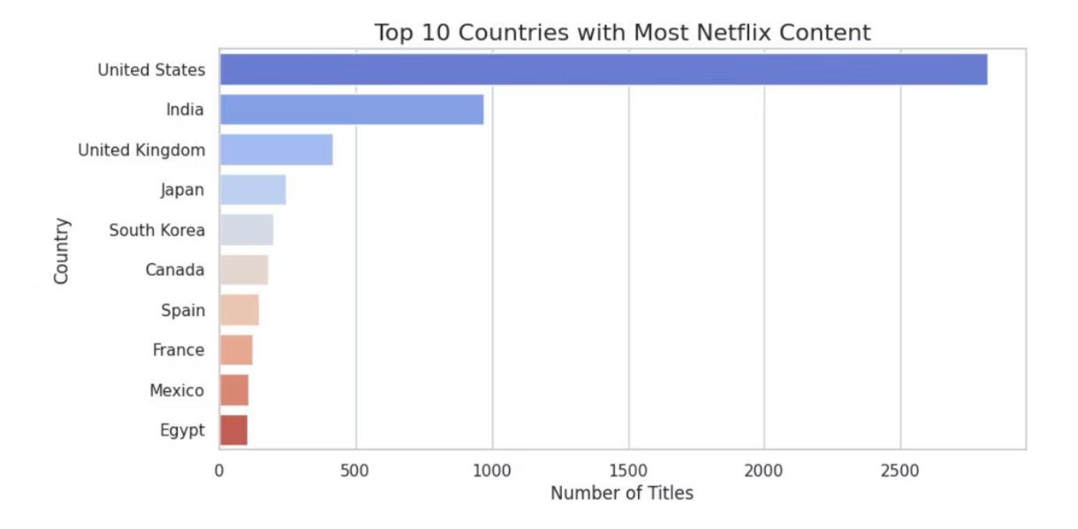
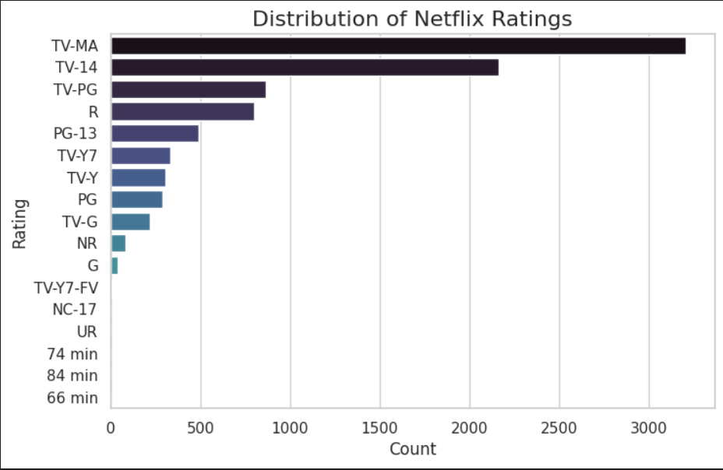
Geographic Content Contributions & Ratings
Understanding which countries contribute the most content and the prevalence of different content ratings provides valuable context.
Top Content Producers
Most Common Ratings
The USA and India are the leading contributors to Netflix's content library, highlighting their significant roles in global entertainment production.
TV-MA and TV-14 are the most frequently occurring content ratings, indicating a predominant focus on mature and teen audiences.

Slide 7
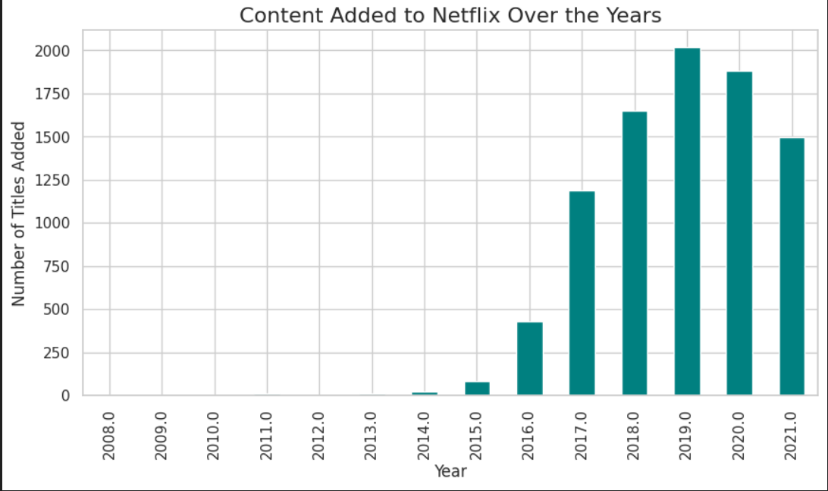
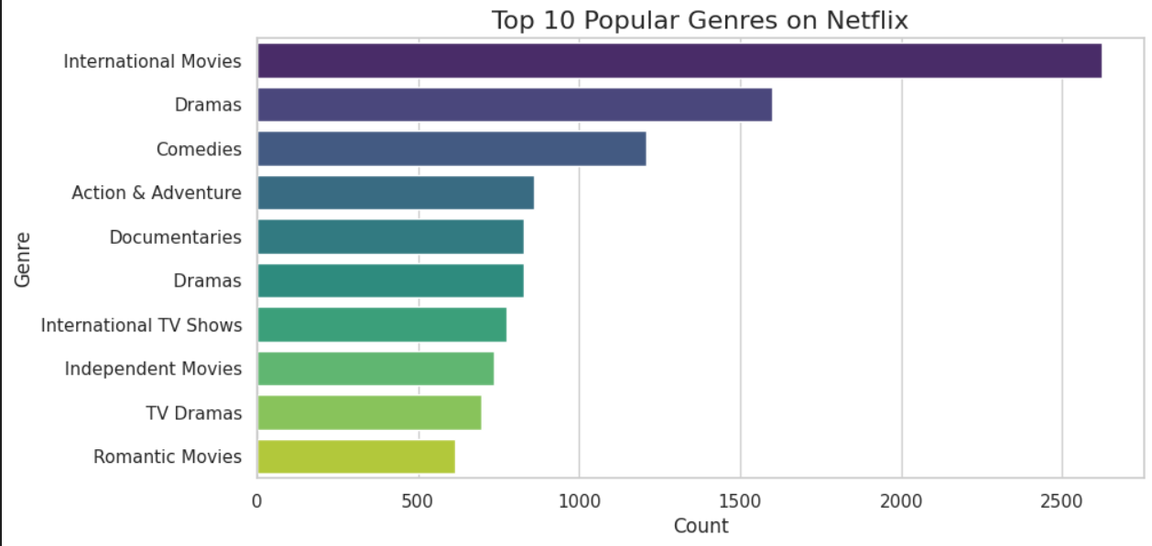
Content Growth & Popular Genres Over Time
Analyzing the trend of content added over the years and identifying the most frequent genres reveals Netflix's expansion and audience preferences.
Content Added Over Years
Top Genres
Netflix's content library experienced rapid growth, particularly after 2015, indicating a significant investment in expanding its offerings.
Dramas and Comedies consistently rank as the most popular genres on Netflix, reflecting broad audience appeal.

Slide 8
Key Insights & Further Analysis
This EDA provides a foundational understanding of the Netflix content landscape, highlighting key trends and characteristics.
1
Movies Dominate
Movies significantly outnumber TV shows in the Netflix library.
2
USA & India Lead Production
These two countries are the primary content contributors.
3
Mature Ratings Common
TV-MA and TV-14 are the most prevalent content ratings.
4
Post-2015 Growth Surge
4
Netflix's content library expanded rapidly after 2015.
5
Drama & Comedy Reign
These genres are the most popular among viewers.
6
Weak Correlation
There's a weak correlation between the year content was added and movie duration.

Slide 9
Thank You

